Slide 1
WEST HATCH PARISH MEETING at 7.00pm on Wednesday 28th July 2021 in the Village Hall Update on Highways England’s (HE) proposals to upgrade the A358 This is an open meeting for the Parish Council to update parishioners about developments on the proposed dualling of the A358 and to hear their views on the project.

Slide 2
Initial HE Proposal (The A358 Wall)

Slide 3
Key Dates
June 2020 Secretary of State (Grant Shapps) Directs implementation of RIS 2 which includes dualling of A358 from Southfield to M5 J25.
Aug 2020 Start of legal action by various groups led by the Transport Action Network over legality of direction in light of climate change commitments.
Nov 2020 Highways England (HE) announce Taylor Woodrow a division of VINCI SA a French construction company have won the detailed design and construction contract to the Pink modified route.
April 2021 £328M contract formally signed with Taylor Woodrow.

Slide 4
Community Engagement
Meetings held by MS Teams except for a short one hour visit by HE Project Manager and Community Engagement Lead 5th July with Keith Read and David Lodge.
March 2021 Community Liaison Forum 2. All parties, present (Keith and Spud for WHPC) nothing new presented on the design. Decision that future meetings would be with smaller groups made by HE following questionnaire. Clear new Taylor Woodrow team are inheriting little detail from previous design agency Mott.
April 2021 Initial meeting of PCs from Mattocks Tree to Southfields to discuss issues and avoid divides at meetings with HE by formulating a common view as all except Neroche had significant objections due to lack of access and crossing points.
May 2021 HE hold separate North/South/Middle meetings with PC reps, SCC, SWT, SSDC and Forestry Commission and a separate Walking, Cycling, Horse Riding (WCH) meeting to discuss and obtain data on access and crossings issues and comment on initial proposals. For WHPC Spud attended plus Spud was invited to WCH session.
June 2021 Community Liaison Forum 3. Held just after the joint PCs proposal was sent to HE. New neutral chair for meetings and some movement by HE

Slide 5
HE Original Design Proposed J25 to Nags Head

Slide 6
HE Original Design Proposed Mattocks Tree to Bickenhall Wood

Slide 7
HE Original Design Proposed Bickenhall Wood to Stewley Cross

Slide 8
HE Original Design Proposed Ashill to Southfields

Slide 9
Joint PCs Proposals

Slide 10
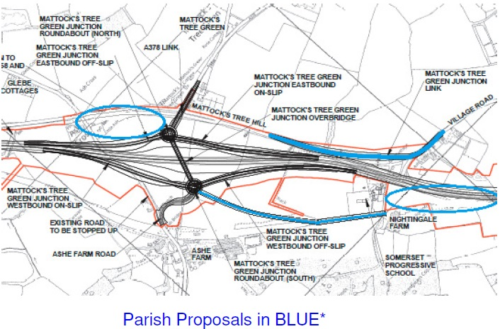
Joint PCs Proposals

Slide 11
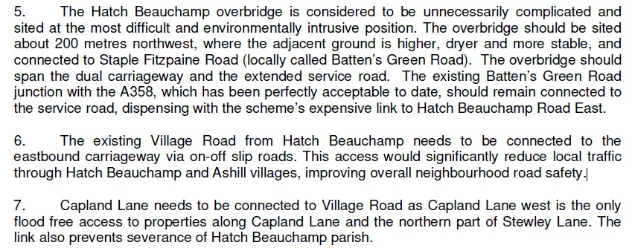
Joint PC Proposals

Slide 12
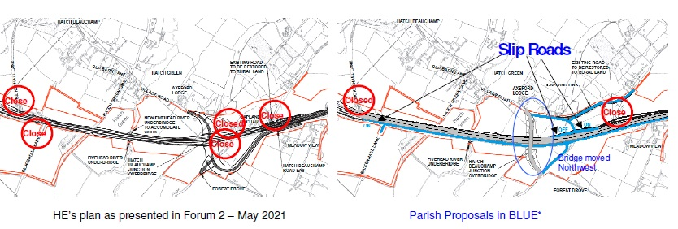
Joint PC Proposals

Slide 13
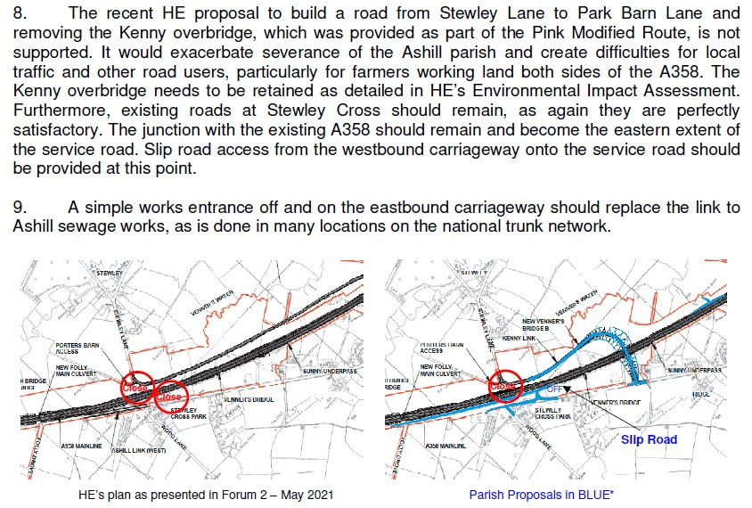
Joint PC Proposals

Slide 14
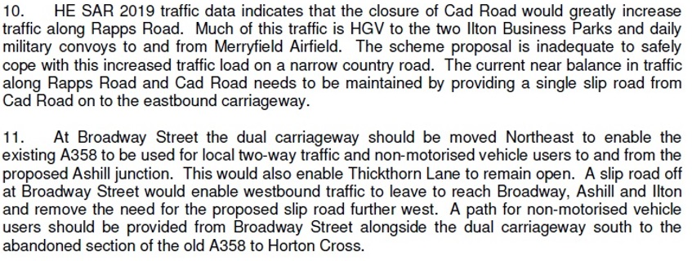
Joint PC Proposals

Slide 15
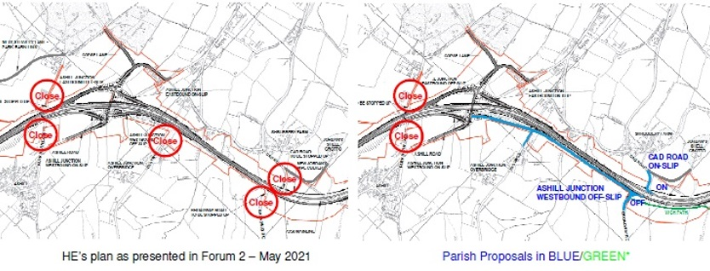
Joint PC Proposals

Slide 16
Latest HE Position
Mattocks Hill to Village Lane Accepted. (No routing through Meare Green)
Mattocks Hill to Special School Accepted. (No routing traffic through lower West Hatch)
Griffin Lane Agreed non viable as a route apart from residents, walkers and horses.
Rapps to Broadway Connection Accepted.
Moving Hatch Green Overbridge Accepted
Crossing at Bickenhall Lane, Bridge proposed for all or WCH + Farm
All additional access slips rejected based on HE GD300 guides

Slide 17
Current Position
Potential increase in traffic from Neroche though Higher West Hatch Lane unless Bickenhall Lane and Access to A358 resolved.
Potential Increase in traffic through village centres of Ashill and Hatch Beauchamp because of absence of access to A358.
HE still reviewing issues around their lack of adherence to GD 300 while using GD300 as a reason to object to additional slip roads. HE cite GD300 as a new set of guidelines hence not being used between Sparkford and Podimore!!!
HE to perform detailed local traffic modelling and understand real topography (not via Google Maps!)
PCs will continue to present a unified front.
Concern that impact on local roads (traffic volume plus loadings/structure degradation) will be dumped on financially compromised new unitary local authority. (e.g. Bickenhall to Battens Green road if traffic forced there by Bickenhall Lane closure)

Slide 18
Will It Ever Happen?
Every PC supports Mattocks Tree to J25
HE say Mattocks Tree To J25 to be built first.
WHPC plus some others in South Somerset keep pointing out that After Mattocks Tree to J25 only upgrading Southfields roundabout is necessary and existing single carriageway which was all newly built in 1990s is adequate to meet future demand.
Seriously objecting to the whole scheme on environmental ground: High Court Case Rejected but expect an appeal. Continued pressure from Transport Action Network, Stonehenge and Lower Thames Crossing pressure groups will likely result in battle over Carbon Impact and RIS 2 Directive by government to go to Supreme Court.

Slide 19
You can download this presentation on the Parish Council Website:- www.westhatchparish.org.uk

